Slide 1
Exploratory Data Analysis Employee Attrition Rate
Definition: “Employee attrition is defined as the natural process by which employees leave the workforce — for example, through resignation for personal reasons or retirement — and are not immediately replaced.”
Vinay Sai . R
Internship: Batch No - 3
rangumudrivinaysai2001@gamail.com

Slide 2
Introduction
Attrition of employees can’t be avoided.
Some employees leave the company as they reach their retirement age, while many leave due to many factors such as, but not limited to, lower satisfaction rate, lower pay rate, and toxic work environment.
Measuring attrition can uncover many answers related to the functioning within the organization.
Higher attrition rates signal a need for further investigation
Once the dataset has been imported, we inspect the dataset to ensure whether each column in the dataset contains values that make practical sense.
In simpler terms, we follow a series of checklists such as checking for outliers, missing values, distribution of each variable and many other basic inspections before diving into the dataset.

Slide 3
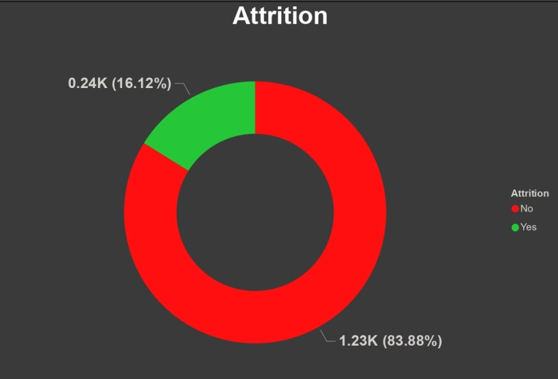
DEFINING OUR METRIC: EMPLOYEE ATTRITION RATE
“Employee Attrition Rate is calculated as the percentage of employees who left the company in a given period to the total average number of employees within that period.”
Attrition Rate = Number of employee left (period) / Average number of employees (period) * 100
= 16.12%
The naive attrition rate for our dataset sample is 16.12%. However, attrition rates generally vary from industry to industry, and region to region.

Slide 4
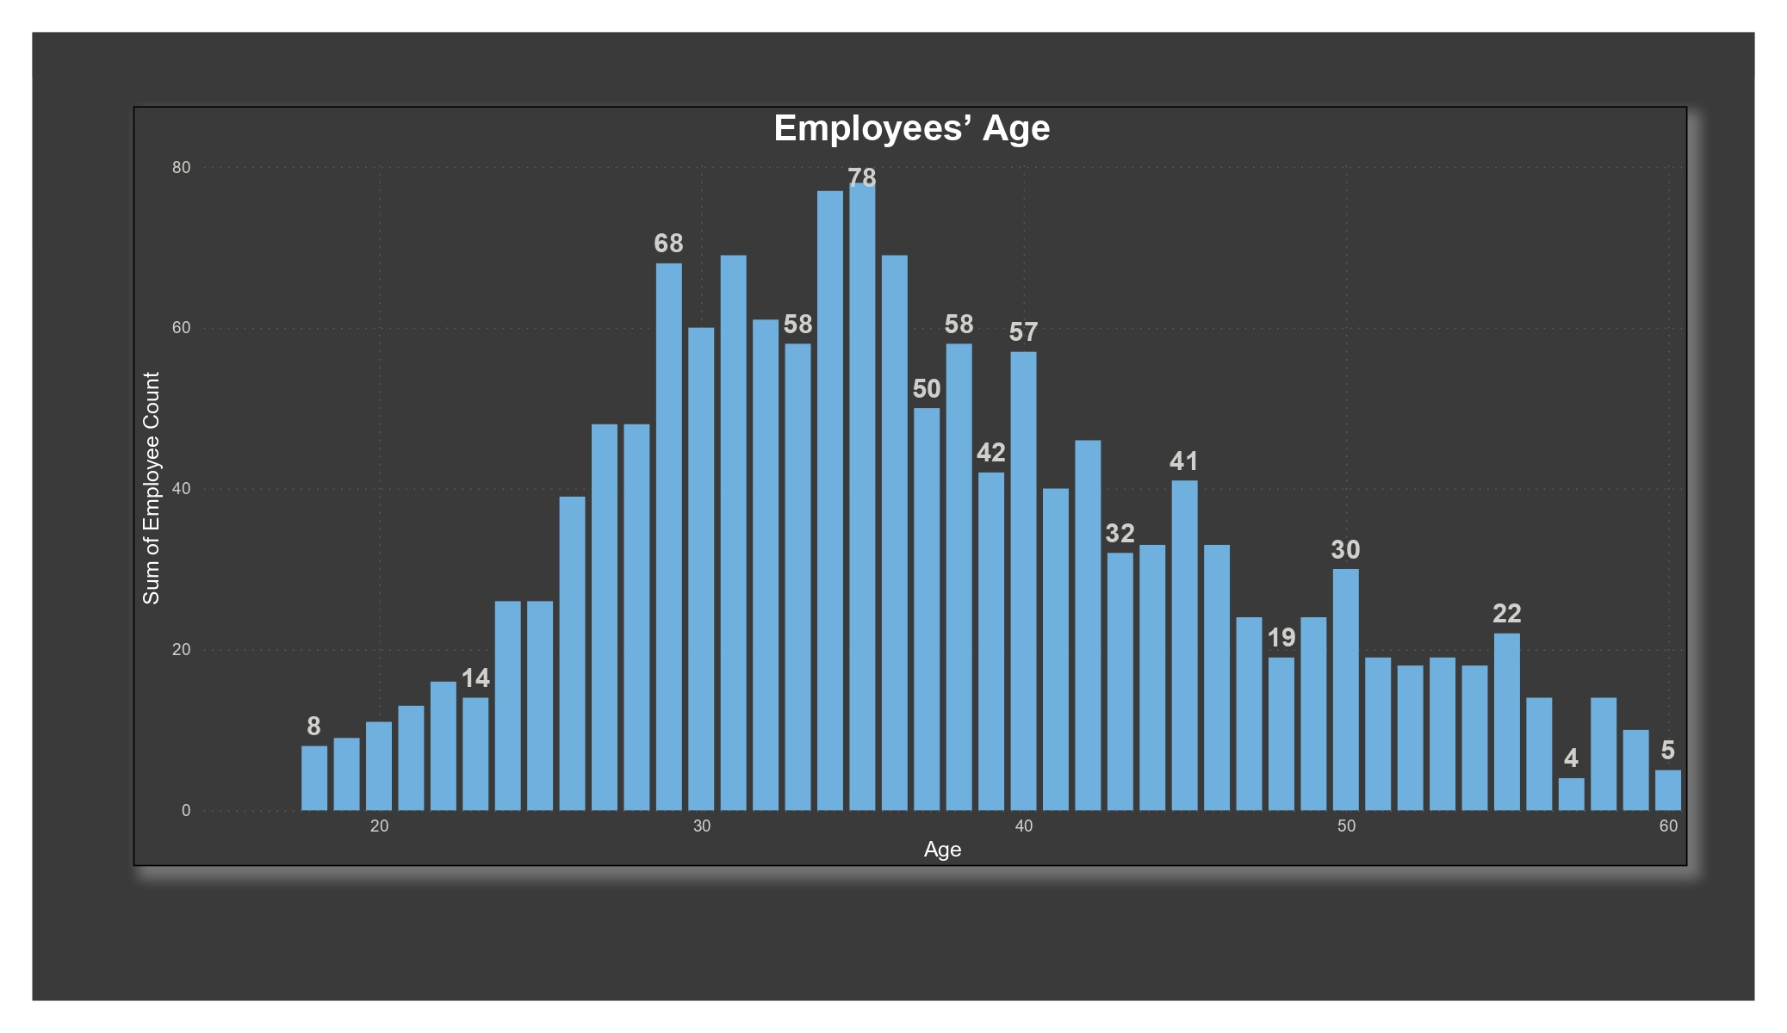
EXPLORATORY DATA ANALYSIS
Age

Slide 5
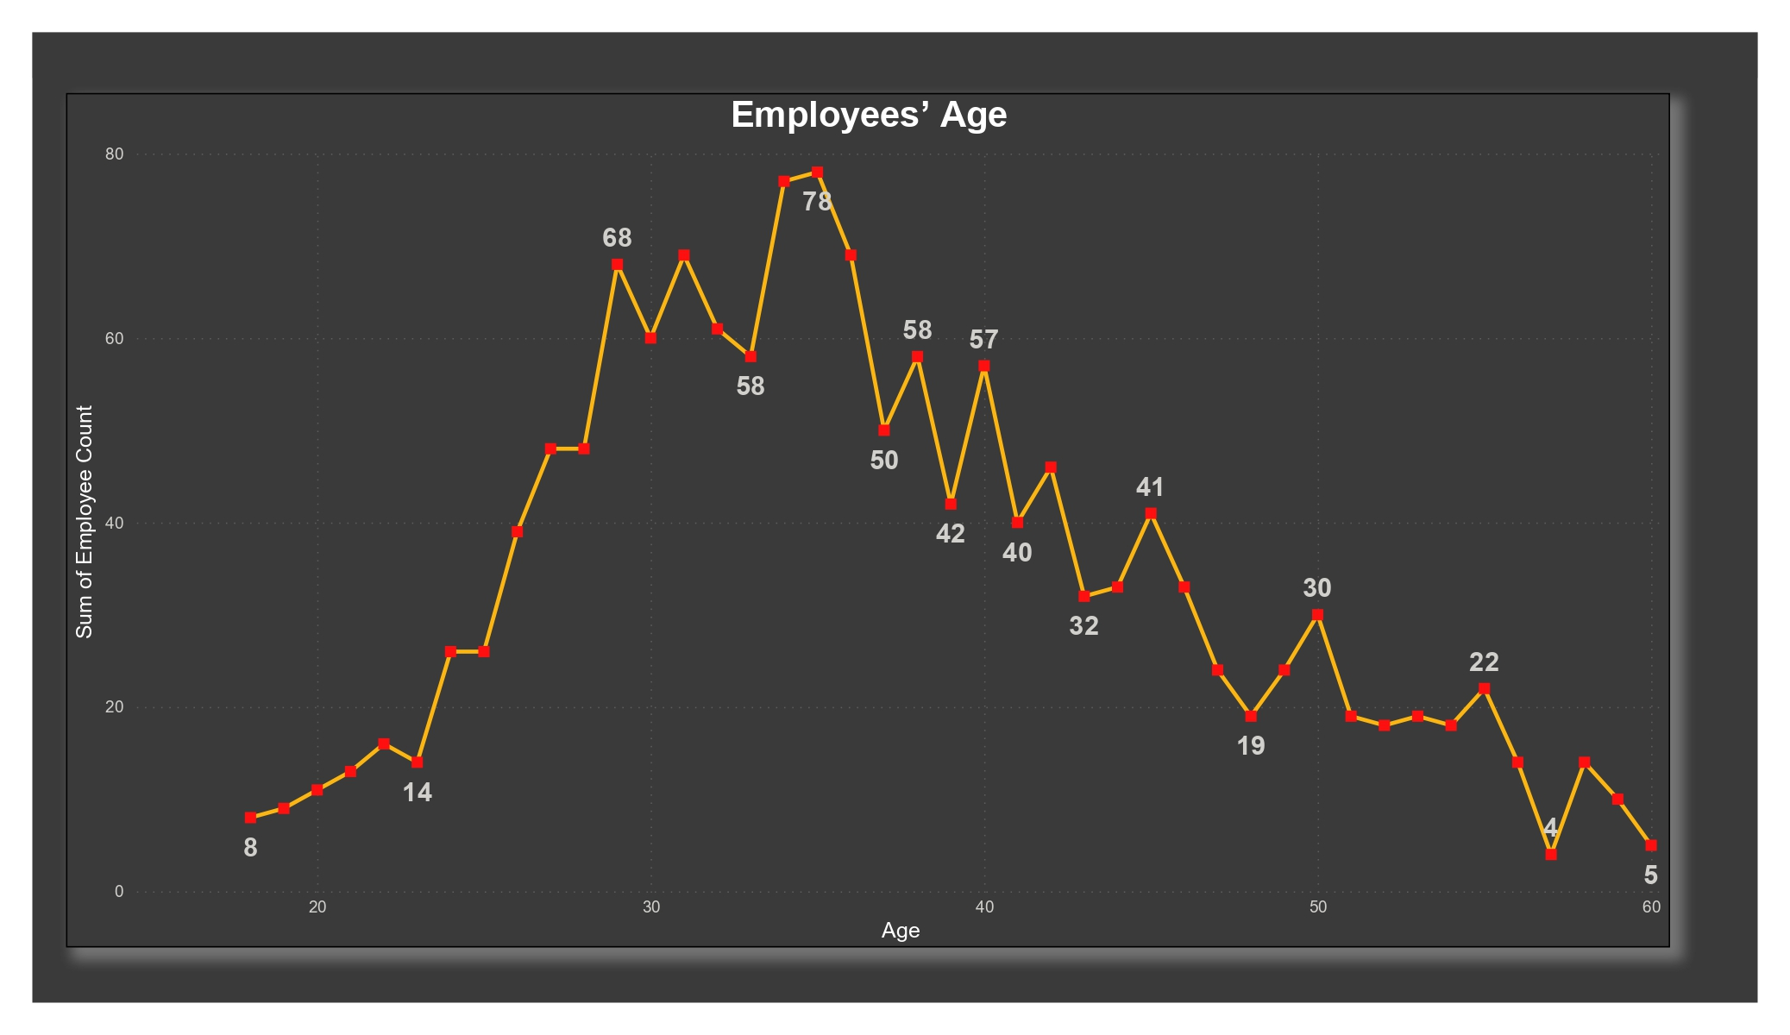
Employee’s Age

Slide 6
Employee’s Age
a) As the mean is almost approximately similar to the median, the distribution of employees’ age is approximately normal with the average age of 36 years.
b) The employees’ age ranges between 18 and 60, which seems to be intuitively true as majorly the unrestricted working age starts from 18 to 60. Additionally, there are no outliers present in the data.
c) Most of the employees, who have been a part of the company, tend to fall in the age range from 25 years to 45 years. (68–95–99 rule)

Slide 7
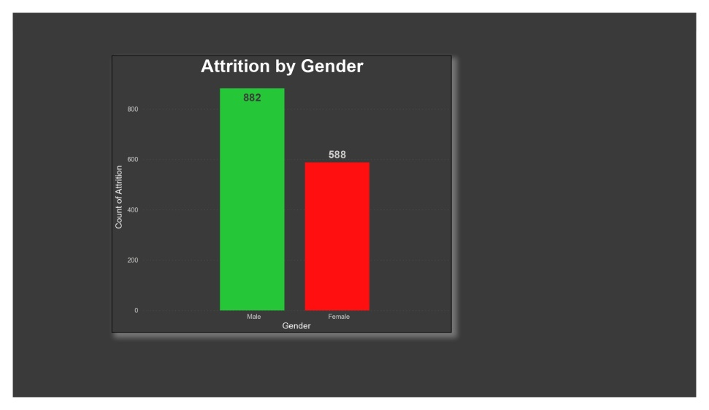
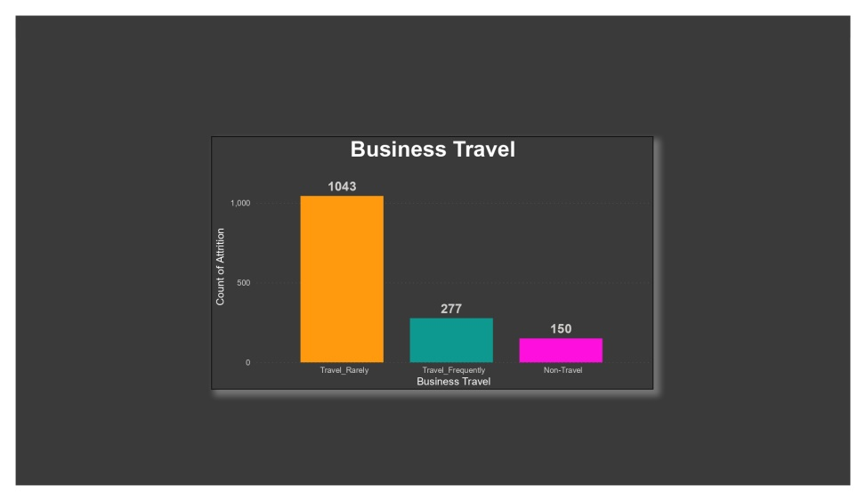
Gender & Business Travel
Gender
Business Travel
Males tend to have a little higher attrition rate than females.
The attrition rate across the type of travel is highly varying, but we can’t conclude whether the type of travel is the cause of the possible attrition.

Slide 8
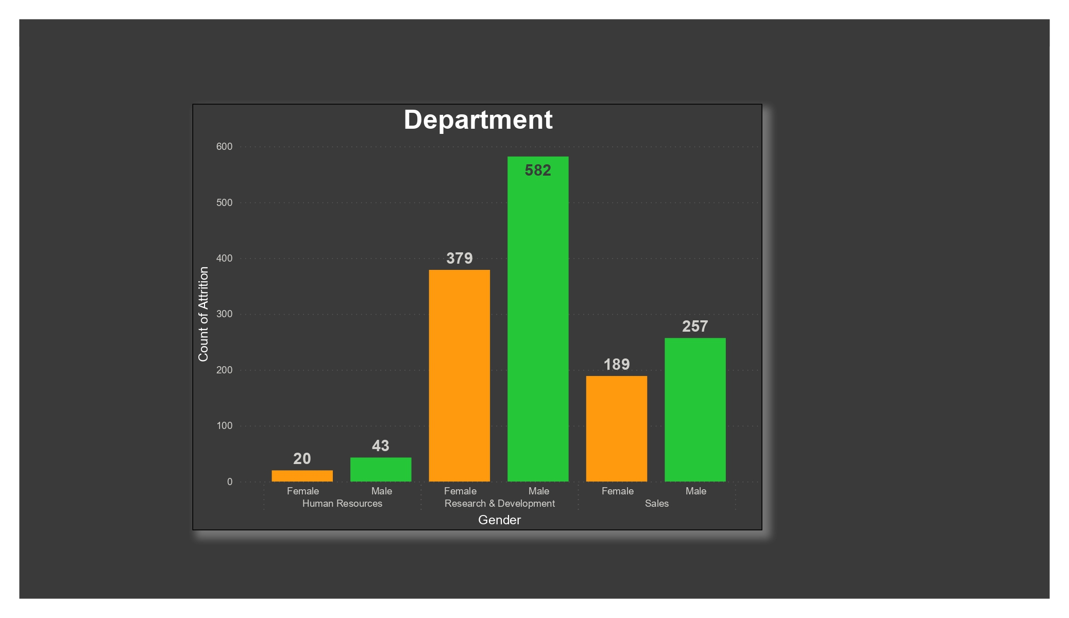
Attrition Rate Per Department
Employees in R&D department seem to have less attrition rate among other department employees, with higher attrition in both Human Resources and Sales Department.
However, when drilled down by gender, females seem to have almost twice the attrition rate as is of the males in HR department.

Slide 9
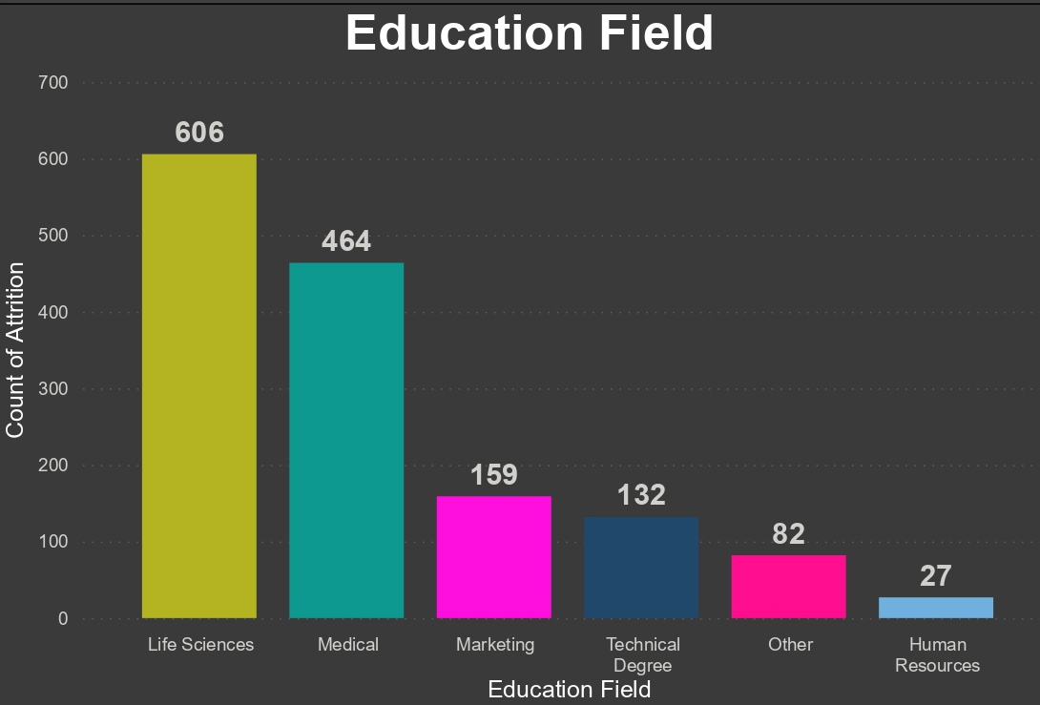
Education Field
Education Field
More of The employees studied in Life Sciences and Medical

Slide 10
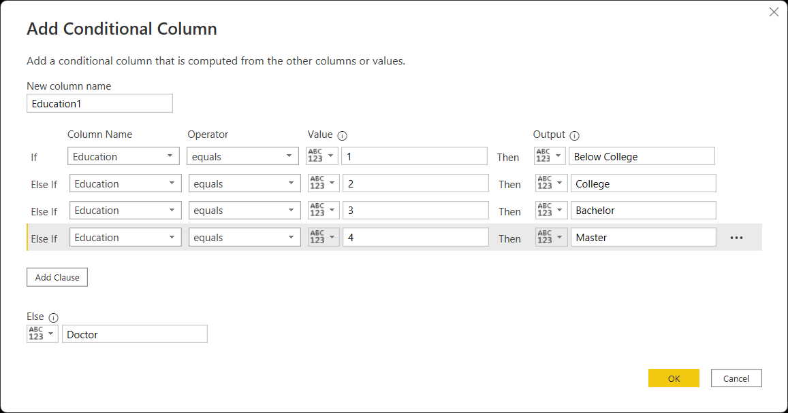
Power Query Editor in Power BI
Educational Level:

Slide 11
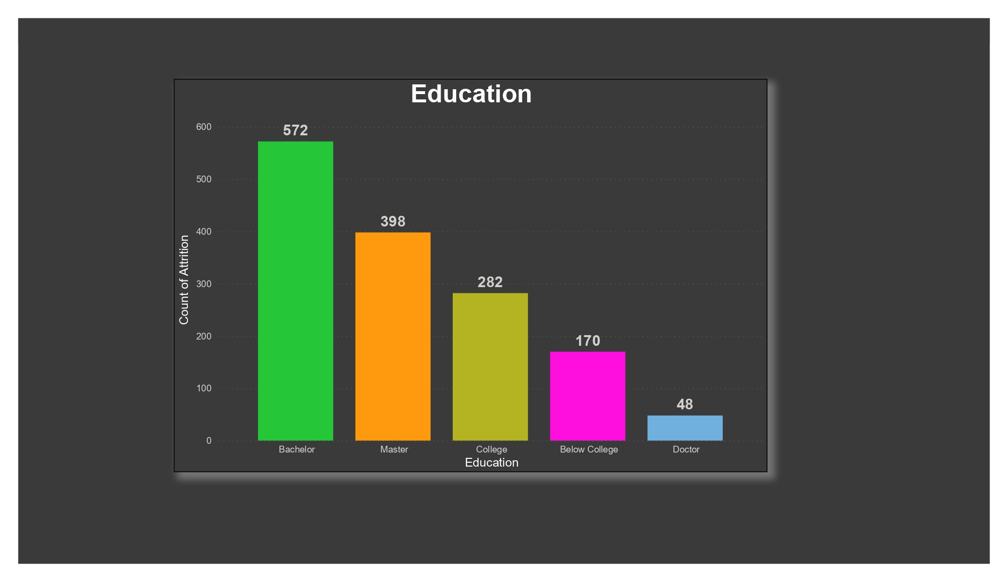
Educational Level:
1 ‘Below College’ 2 ‘College’ 3 ‘Bachelor’ 4 ‘Master’ 5 ‘Doctor’
There is some correlation among the attrition rates in the educational levels. With lower education level employees having higher attrition rates.
b) Educational Field: Business and technical employees seem to have a higher tendency to leave the company than medical field employees.

Slide 12
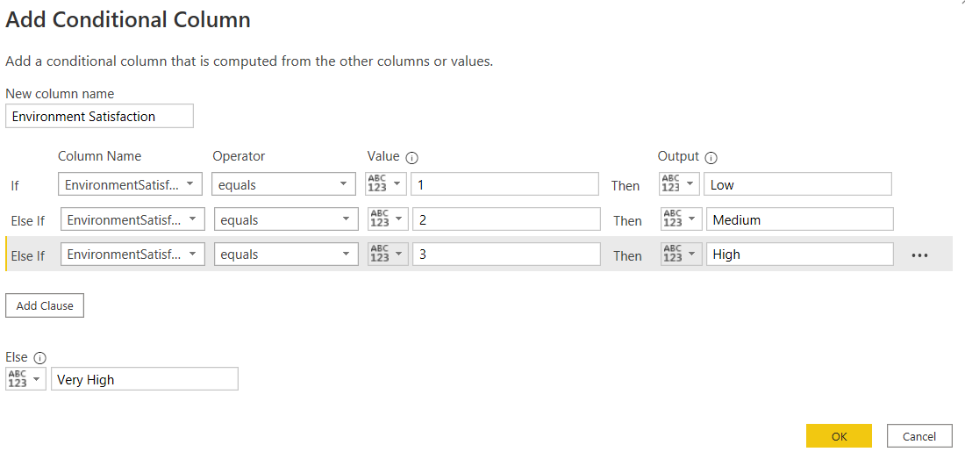
Environment Satisfaction
Environment Satisfaction: 1 ‘Low’ 2 ‘Medium’ 3 ‘High’ 4 ‘Very High’

Slide 13
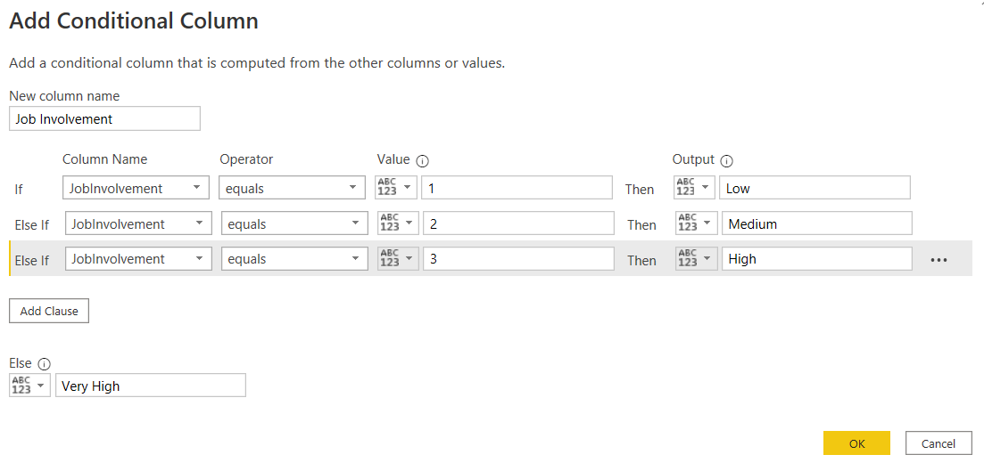
Job Involvement
Job Involvement: 1 ‘Low’ 2 ‘Medium’ 3 ‘High’ 4 ‘Very High’

Slide 14

Job Satisfaction
Job Satisfaction: 1 ‘Low’ 2 ‘Medium’ 3 ‘High’ 4 ‘Very High’

Slide 15

Work Life Balance
Work Life Balance: 1 ‘Bad’ 2 ‘Good’ 3 ‘Better’ 4 ‘Best’

Slide 16
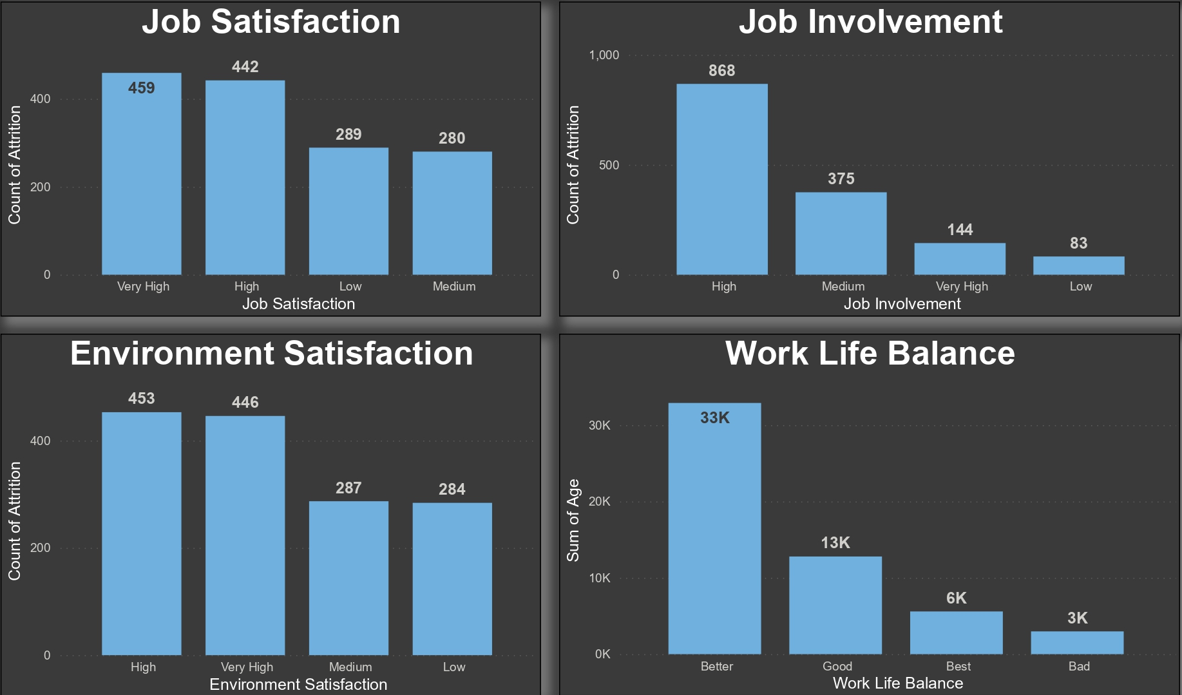
Satisfaction and Well-Being
Intuitively, it can be clearly seen that dissatisfied employees having lower satisfaction and poor work life balance tend to have a higher attrition rate than their other counterparts.

Slide 17
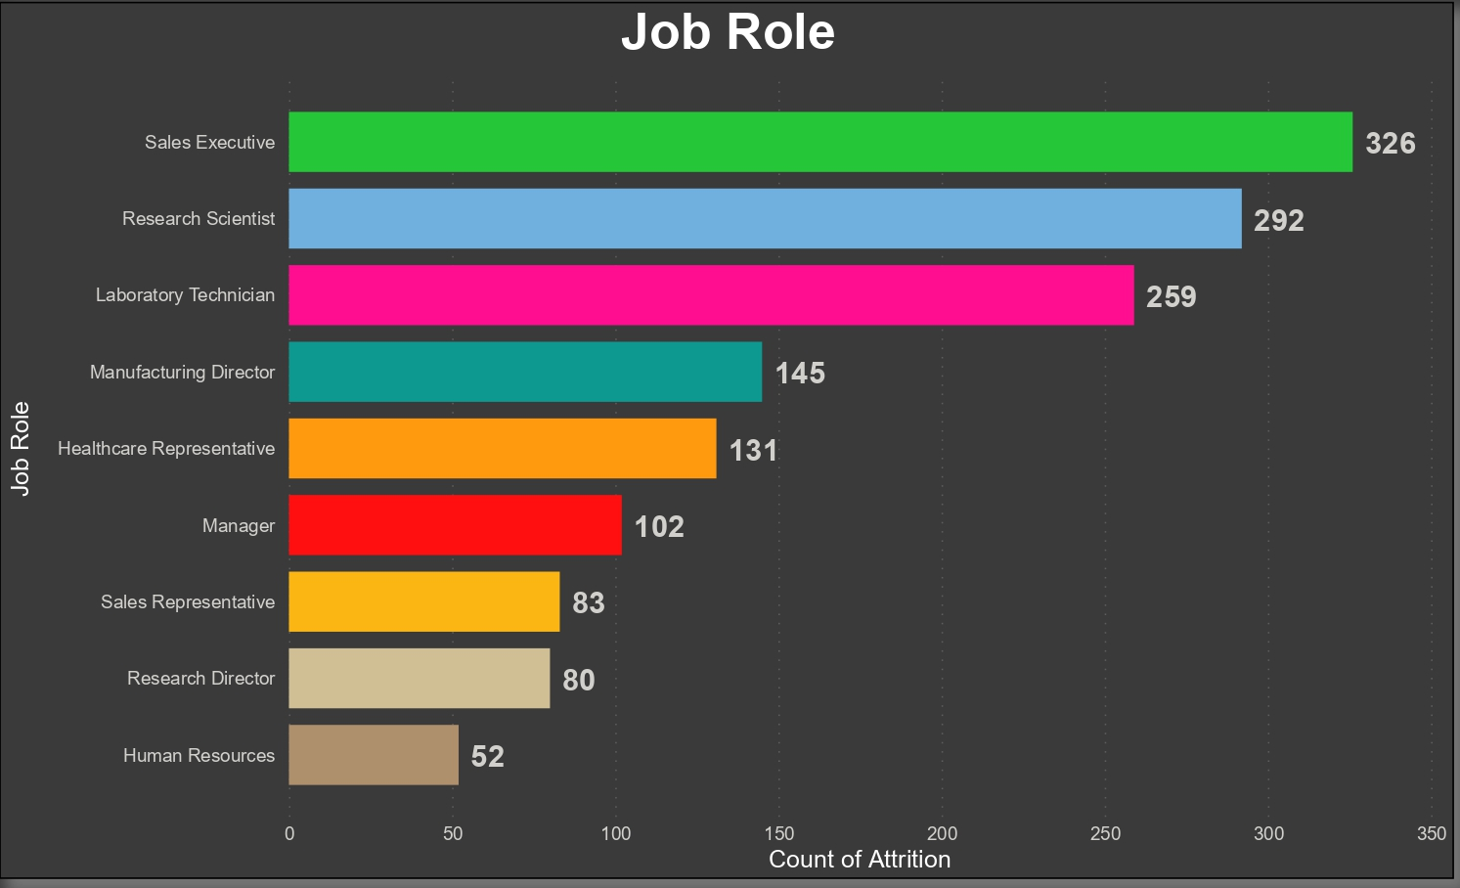
Job Level and Job Role
Job Role
Job Role: Sales Representatives followed by Human Resources and Lab Tehnicians tend to leave the company the most.

Slide 18
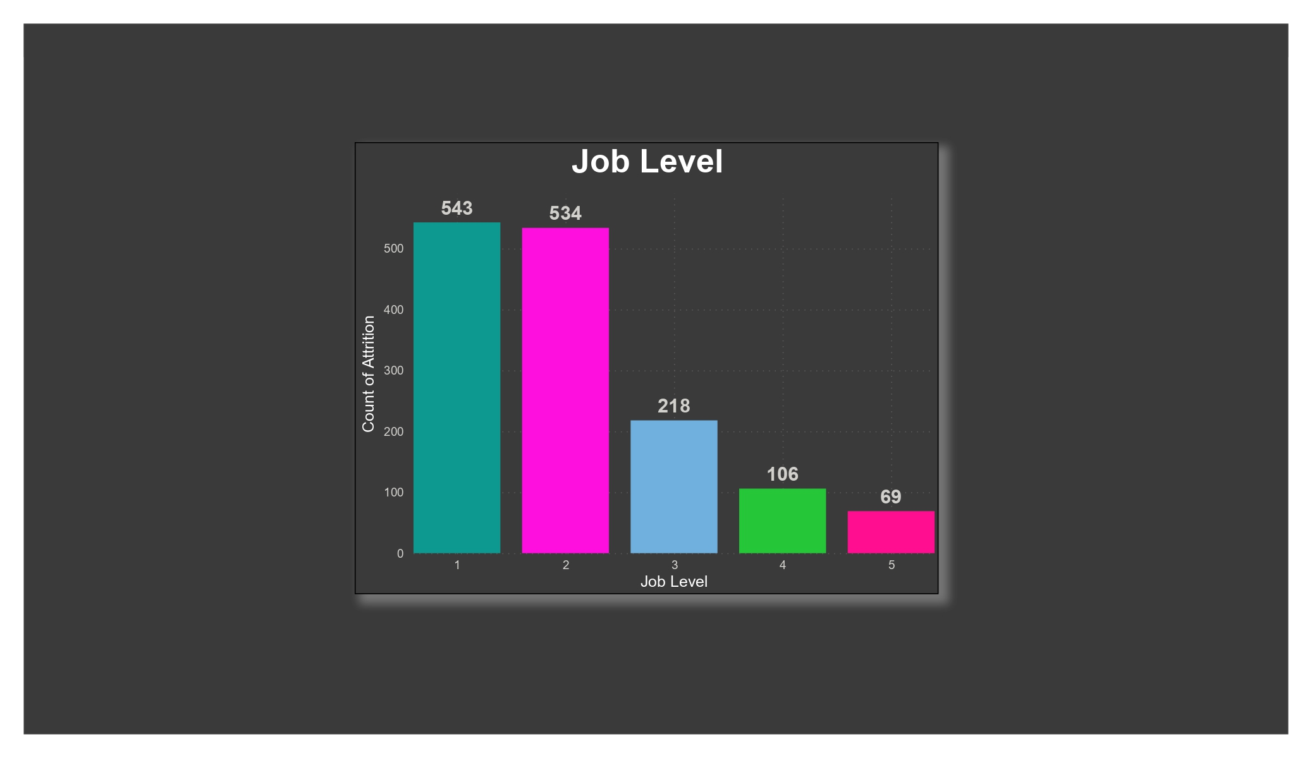
Job Level
Job Level: Less experienced employees comprise of a higher proportion of employees leaving the company.

Slide 19
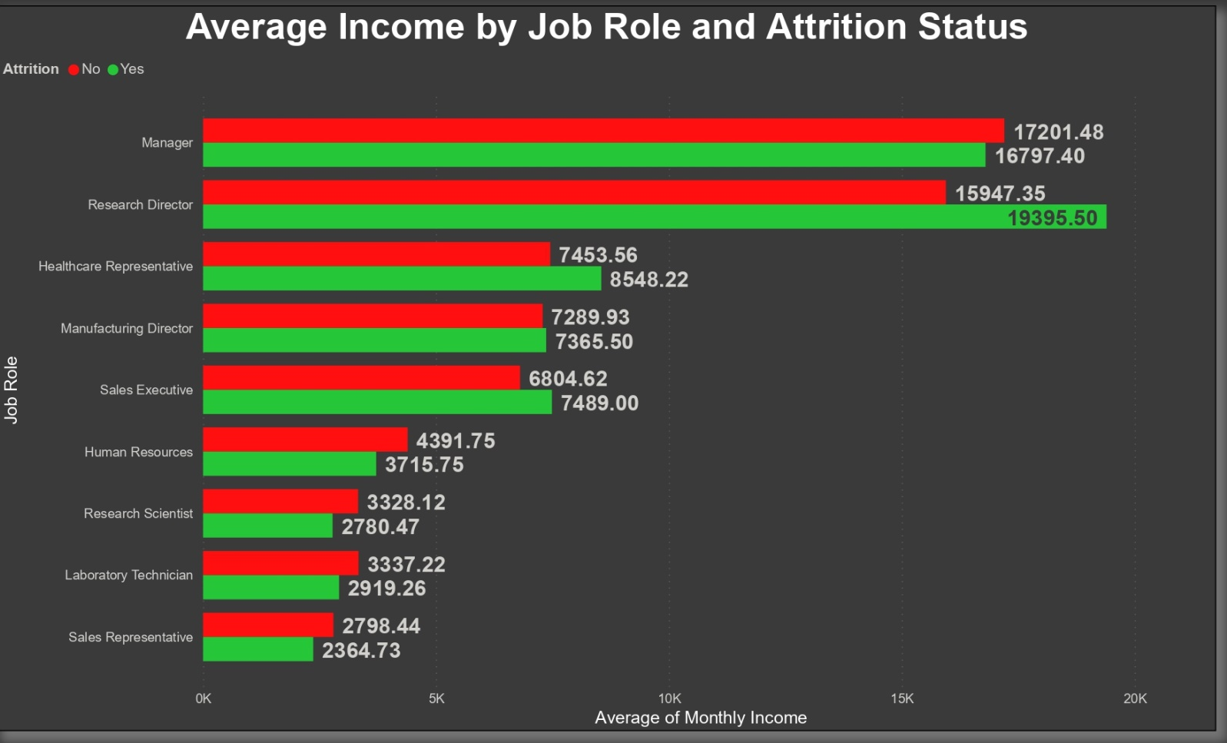
Average Income By Job Role and Attrition Status
I try to analyze the income per each job Role. In the plot above shows us that for the same level of Job Satisfaction Score there is a big gap of (median) income between those who leave the company and those who stay.
Manger position in a Job Role Is height payed position.

Slide 20
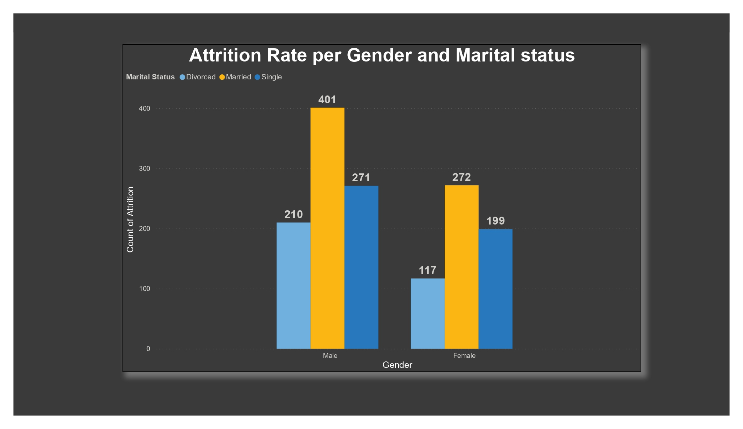
Gender and Marital status
Attrition Rate Per Gender and Marital status
Gender Difference in Divorced, Married And Single as per Attrition Rate

Slide 21
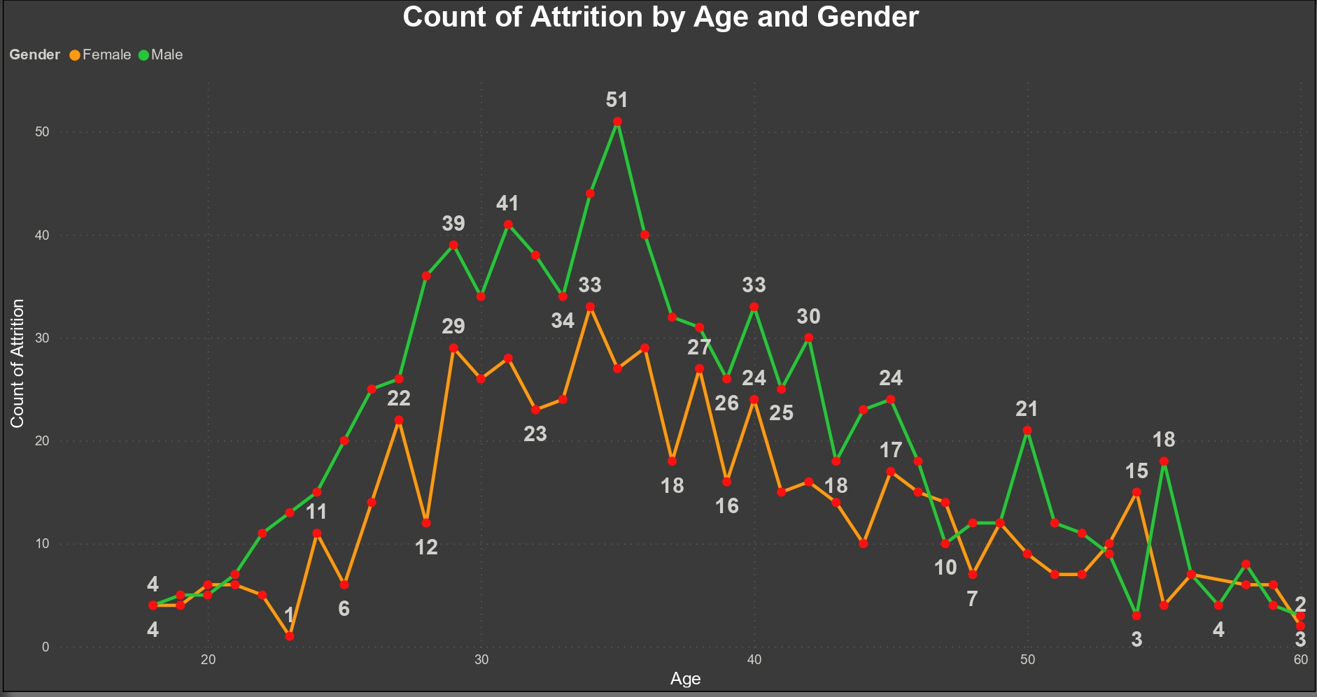
Age and Gender
Age Difference in Female and Male

Slide 22
Conclusion
From the EDA section above we know that the current attrition rate is 16 %.
There are several factors that have a distinct pattern and probably leads to increasing of rate of employees attrition such as salary hike, working overtime, and Stock Option Levels.
By learning the data and visualize it, we can gain some insight and become foundation to develop strategic planning

